Slide 1


MOTIVATION
Ms. Aisha Bano
aisha.bano@nu.edu.pk

Slide 2
INTRODUCTION TO MOTIVATION
Origin
Motivation is derived from the Latin word “movere” which means “to move” or “to energize” or “to activate”.
Definitions
1. Motivation (Learn at least 2)
A process that arouses, maintains and guides behavior toward a goal. (Cacioppo & Freberg, 2013)
It refers to all the internal conditions that stir up activity and sustain activity of an individual. (Guilford)
The term motivation refers to the states within a person or animal that drives behavior toward some goals. (Morgan & King)
An internal force to achieve goal.

Slide 3
INTRODUCTION
2. Need: A motivating force that compels actions for its satisfaction.
3. Drive: A state of tension and arousal triggered by cues important for survival.
4. Incentive: A reward that pulls on organism’s behavior in a particular direction.
Types of reward
i) Intrinsic Reward: A type of reward that tends to give personal satisfaction to the individual e.g. feedback, acknowledgment.
ii) Extrinsic Reward: A concrete reward received by the individual from external environment e.g. promotions, money, fringe benefits, grades, wages, salaries
5. MOTIVE
Psychological state (perceived as a ‘need’) that moves us to engage on an organized set of behaviors that maximize the fulfillment of that motive.

Slide 4
INTRODUCTION (slide not included in exam)
PROPERTIES OF MOTIVES:
The WHY of behavior
Not directly observable (i.e.. inferred from behavior)
Conscious and unconscious
Approach and avoidance motives
Variable and constant

Slide 5
THEORIES OF MOTIVATION
McClelland's Theory of Needs (from M-2 attached slides)
Maslow Theory of Human Motivation (from M-2 attached slides)
Vroom’s Expectancy Theory of Motivation
Adams’ Equity Theory of Motivation

Slide 6
Vroom’s Expectancy Theory of Motivation
In 1964, Canadian professor of psychology Victor Vroom from the Yale School of Management developed this theory. In it, he studied people’s motivation levels and concluded that human motivation depends on three factors: expectancy, instrumentality and valence.
Victor Vroom distinguishes between the effort people put in, their performance and the final result. His theory primarily relates to motivation within a work environment. He concluded that putting in effort will result in a desirable reward.
When employees can make choices in their work, Victor Vroom argues that they will mostly choose that what motivates them the most.
Victor Vroom uses a formula to calculate the motivational force: Motivational force = Expectancy x Instrumentality x Valence

Slide 7
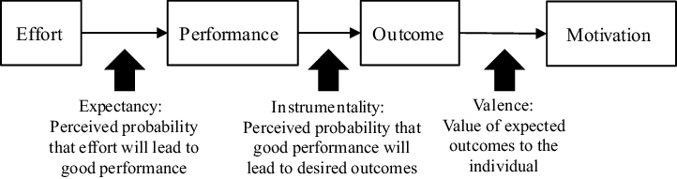
Vroom’s Expectancy Theory of Motivation (choose either slide 7 or 8)

Slide 8
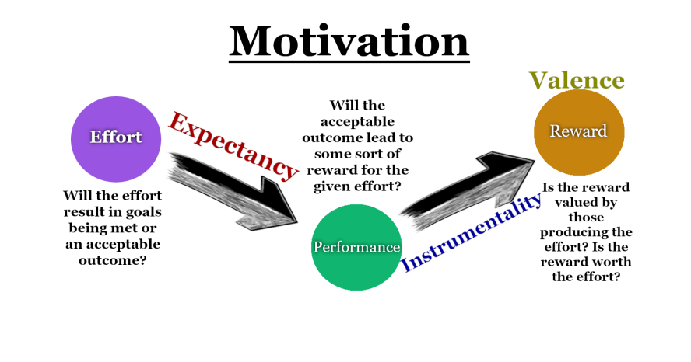
Vroom’s Expectancy Theory of Motivation (choose either slide 7 or 8)

Slide 9
3 Components of Expectancy Theory
1. Expectancy
This is about what employees expect from their own efforts (expected outcome) and the relation to good performance and outcomes (performance expectancy). Part of this expectation is the level of difficulty he experiences, i. e. goal difficulty.
An organisation can respond to that by finding out which factors can motivate the employee to deliver his best possible performance. It’s about the connection between performance and right sources of motivation.
Those factors can be facilities, training or support from a supervisor who builds his employees’ confidence. Victor Vroom indicates that, in general, more effort leads to better performance.

Slide 10
3 Components of Expectancy Theory
2. Instrumentality
Each employee is a cog in the machine and an instrument that contributes to the business results. Instrumentality is the belief and from that perspective, instrumentality isn’t difficult to grasp. It’s about the employee’s performance being good enough to achieve the desired outcome.
An organisation can stimulate this by actually making good on promises of additional rewards such as bonuses or promotion. The employee has to believe that if he performs well, appreciation will be shown for the results.
Transparency throughout the reward process is an important condition for instrumentality.
3. Valence
The final result that employees achieve is valued differently by each individual. This value is based on their own basic needs. As such, it’s a good idea for an organisation to find out what an individual employee values and what his personal needs are like sources of motivation. One might value money, while another values more days off.

Slide 11
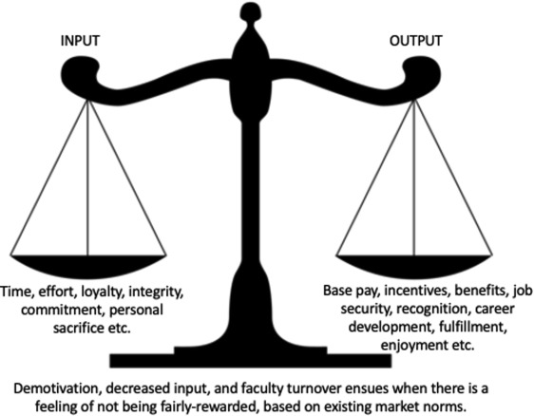
Equity theory of motivation by Stacey Adams

Slide 12
Equity theory of motivation by Stacey Adams
The Adams Equity Theory was developed by the American psychologist John Stacey Adams in 1963. The theory shows why salary and benefits alone don’t determine an employee’s motivation. It explains why a promotion or raise rarely has the desired effect. It can even undermine the motivation of other employees. Employees place great importance on being treated fairly and equally.
This ensures that they’ll be motivated at work. It’s treating different employees differently and unfairly that leads to bad blood and will damage a lot of people’s motivation. After all, we all wanted to be treated fairly. When that’s not the case, employees will be unhappy, which can manifest itself in different ways.
For instance, they won’t perform optimally, and there’ll be a risk of high employee turnover as employees choose to try their luck at another employer. That’s why fair treatment of everyone involved is essential.

Slide 13
2 Components of Equity Theory
The input referred to in Adams Equity Theory includes both the quantity and the quality of the contributions employees make to carrying out their work. They spend time, energy, and engagement at work.
They work hard, share ideas, trust their superiors and support their co-workers. The number of examples are endless, but the most common forms of input are listed below:
1. Effort
2. Skills
3. Knowledge
4. Experience
5. Social skills
6. Loyalty
Employees’ output can generally be divided into 1) financial rewards, 2) immaterial rewards. The most common forms of output are discussed based on this division.
1. Financial rewards
Salary
Bonus
Profit sharing
2. Immaterial rewards
Recognition
Employees want to be intrinsically motivated. This means they feel Challenge
Responsibility
As a result, responsibility leads to intrinsic motivation. The employees feel that they matter in the organisation.

Slide 14
Measurement of Motives (Not included in syllabus)
Direct Methods
In this measurement, an individual expresses his/her motives through verbal or overt behavior.
Required information is taken from the primary source.
The techniques or methods used to know the motives of an individual are questionnaire, inventories, autobiography and other self descriptive measures

Slide 15
Measurement of Motives (Not included in syllabus)
Indirect Methods
The following methods are used when an individual is either unaware of its motives or is determined not to reveal its real motive.
Techniques like Rorschach Ink blot test (RIT), Thematic Apperception Test (TAT), Child Apperception Test (CAT), House Tree Person (HTP) test etc.
Required information is gained through sketching or drawing ,associating a word or playing a role etc.

